Slide 1
CHAPTER 4 research design

Slide 2
Chapter Outline (slide 1 of 2)
Introduction
Three Purposes of Research
The Logic of Nomothetic Explanation
Necessary and Sufficient Causes
Units of Analysis
The Time Dimension

Slide 3
Chapter Outline (slide 2 of 2)
How to Design a Research Project
The Research Proposal
The Ethics of Research Design
Chapter Summary
Questions

Slide 4
Three Purposes of Research (slide 1 of 3)
Exploration
To satisfy the researcher’s curiosity and desire for better understanding
To test the feasibility of undertaking a more extensive study
To develop the methods to be employed in any subsequent study
Examples?

Slide 5
Three Purposes of Research (slide 2 of 3)
Description
Describe situations and events through scientific observation
Examples?

Slide 6
Three Purposes of Research (slide 3 of 3)
Explanation
Descriptive studies answer questions of what, where, when, and how
Explanatory studies answer questions of why
Examples?

Slide 7
The Logic of Nomothetic Explanation
Goal: to find a few factors that can account for many of the variations in a given phenomenon.

Slide 8
Example: Legalization of Marijuana
Idiographic Approach
Nomothetic Approach
Asking one person what influenced her views:
Parents, teachers, clergy, previous experiences
Finding out about the numerous (cross-cutting) factors that influence general opinion
Political orientation, gender, occupation, education

Slide 9
The Logic of Nomothetic Explanation
Criteria for Nomothetic Causality
The variables must be correlated
The cause takes place before the effect
The variables are nonspurious
Spurious Relationship – A coincidental statistical correlation between two variables shown to be caused by some third variable

Slide 10
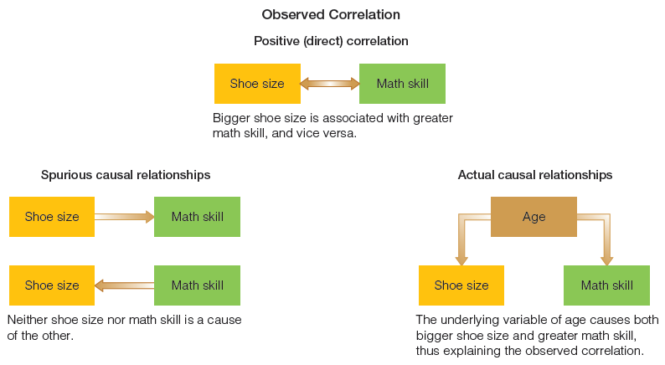
Figure 4-1
An Example of a Spurious Causal Relationship
Finding an empirical correlation between two variables does not necessarily establish a causal relationship. Sometimes the observed correlation is the incidental result of other causal relationships, involving other variables.

Slide 11
The Logic of Nomothetic Explanation (slide 1 of 2)
Nomothetic Causal Analysis and Hypothesis Testing
Hypotheses are not required in nomothetic research.
To test a hypothesis:
Specify variables you think are related
Specify measurement of variables
Hypothesize correlation, strength of relationship, statistical significance
Specify tests for spuriousness

Slide 12
The Logic of Nomothetic Explanation (slide 2 of 2)
False Criteria for Nomothetic Causality
Complete Causation
Exceptional Cases
Majority of Cases

Slide 13
Necessary and Sufficient Causes
A necessary cause represents a condition that must be present for the effect to follow.
A sufficient cause represents a condition that, if present, guarantees the effect in question.
Most satisfying outcomes in research include both necessary and sufficient causes.

Slide 14
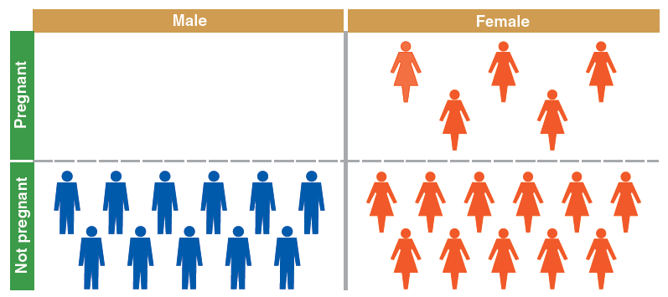
Figure 4-2
Necessary Cause
Being female is a necessary cause of pregnancy, that is, you can’t get pregnant unless you’re female.

Slide 15
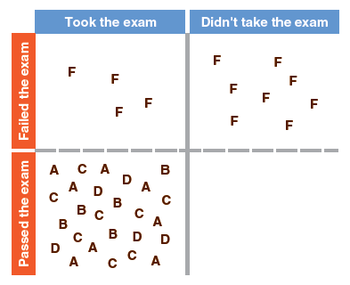
Figure 4-3
Sufficient Cause
Not taking the exam is a sufficient cause of failing it, even though there are other ways of failing (such as answering randomly).

Slide 16
Units of Analysis (slide 1 of 2)
Aggregates versus Individuals
Individuals
Most common unit of analysis for social research
Groups
Organizations
Social Interactions

Slide 17
Units of Analysis (slide 2 of 2)
Individuals
Students, voters, parents, children, Catholics
Groups
Gang members, families, married couples, friendship groups
Organizations
Corporations, social organizations, colleges
Social Interactions
Telephone calls, dances, online chat rooms, fights
Social Artifacts
Social Artifact – any product of social beings or their behavior.

Slide 18
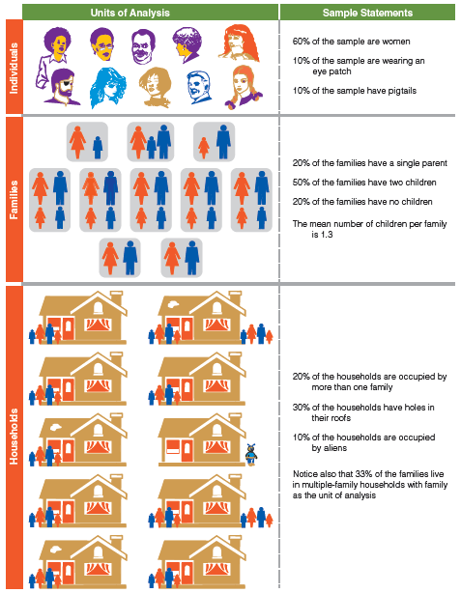
Figure 4-4
Illustration of Units of Analysis
Units of analysis in social research can be individuals, groups, or even nonhuman entities.

Slide 19
Units of Analysis
Faulty Reasoning about Units of Analysis
The Ecological Fallacy
erroneously drawing conclusions about individuals solely from the observations of larger units of analysis.
Reductionism
erroneously drawing conclusions about a phenomenon by looking at aspects of lower level concepts.

Slide 20
The Time Dimension (slide 1 of 2)
Cross-Sectional Study – A study based on observations representing a single point in time, a cross section of a population.

Slide 21
The Time Dimension (slide 2 of 2)
Longitudinal Study – A study design involving the collection of data at different points in time.
Trend Study – A study in which a given characteristic of some population is monitored over time.
Cohort Study – A study in which some specific subpopulation, or cohort, is studied over time.
Panel Study – A study in which data are collected from the same set of people at several points in time.

Slide 22
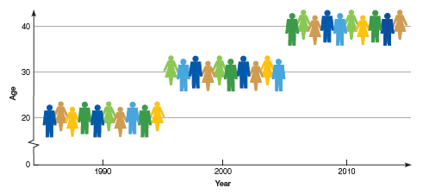
Figure 4-5
A Cohort Study Design
Each of the three groups shown here is a sample representing people who were born in 1970.

Slide 23
The Time Dimension
Comparing Types of Longitudinal Studies, Example: Religious Affiliation
Trend Study
looks at general shifts in religious affiliation over time.
Cohort Study
follows shifts in religious affiliation among those born during the Depression.
Panel Study
follows the shifts in religious affiliation among a specific group of people over time.

Slide 24
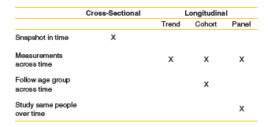
Figure 4-6
Comparing Types of Study Design

Slide 25
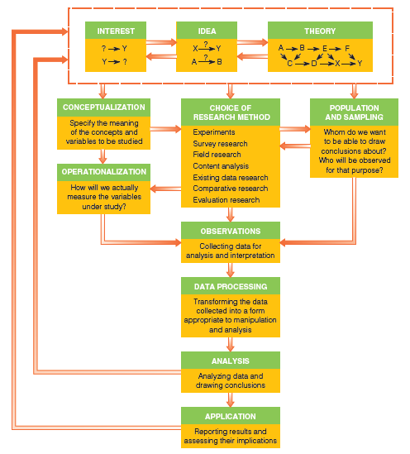
Figure 4-7
The Research Process
Here are some of the key elements that we’ll be examining throughout this book: the pieces that make up the whole of social research.

Slide 26
How to Design a Research Project
Define the purpose of your project – exploratory, descriptive, or explanatory?
Specify the meanings of each concept you want to study
Select a research method
Determine how you will measure the results
Determine whom or what to study
Collect empirical data
Process the data
Analyze the data
Report your findings

Slide 27
A General Research Proposal Outline
Elements of a Research Proposal
Problem or Objective
Literature Review
Subjects for Study
Measurement
Data Collection Methods
Analysis
Schedule
Budget
Institutional Review Board

Slide 28
The Ethics of Research Design
Research design should indicate how your study will abide by the ethical strictures of social research
May be appropriate for an institutional review board to review your research proposal

Slide 29
Chapter Summary (slide 1 of 2)
Discuss the role of exploration, description, and explanation in social research.
Discuss the logic and procedures of idiographic explanation.
Name and discuss the legitimate and false criteria for nomothetic explanation.
Distinguish between necessary and sufficient causes, giving examples.
Identify some of the common units of analysis in social research and explain why that concept is important.

Slide 30
Chapter Summary (slide 2 of 2)
Identify and describe some common study designs based on the time dimension.
Explain and illustrate some advantages of mixed-mode designs.
Identify and discuss the key elements in the design of a research project.
Describe the elements and structure of a research proposal.
Give examples of how research design can have ethical implications.

